Slide 1
Arizona Environmental Strategic Alliance May 16, 2023
Pinal County Air Quality Control
Scott DiBiase, Interim Director

Slide 2
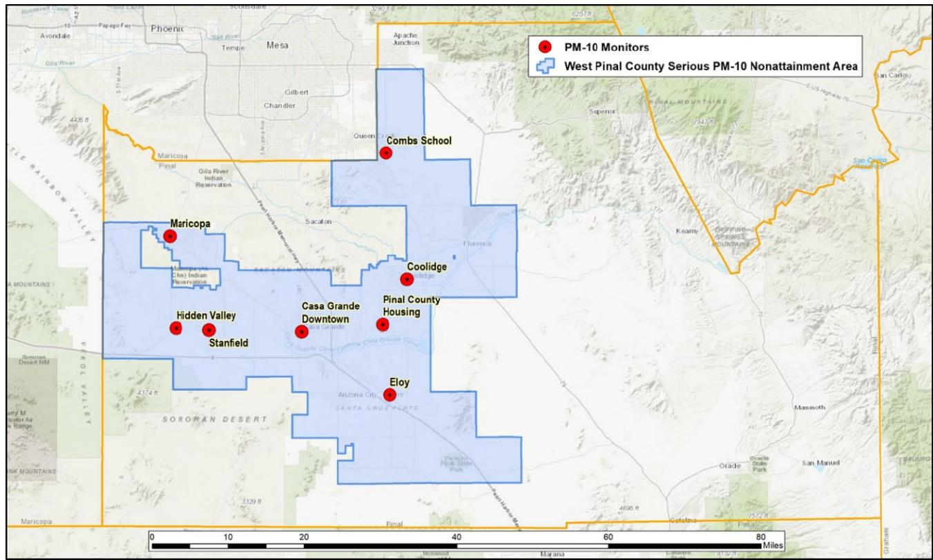
West Pinal Serious PM₁₀ Nonattainment Area
Source: 2022 Serious Area Particulate Plan for PM-10 For The West Pinal County Nonattainment Area, May 2022. Maricopa Association of Governments [MAG SIP]

Slide 3
West Pinal State Implementation Plan (SIP)
2020 - West Pinal redesignated to Serious PM₁₀ NAA (attainment by end of 2022)
MAG Serious Area “Commitments” SIP submitted to EPA May 2022
Pinal County BOS Adopted more stringent construction/general fugitive dust rules in January, go into effect June 1st.
EPA has approvability issues with submitted SIP
2/15/23 - EPA Proposed Finding of Failure to Attain (by 12/31/22)
MAG 5% plan due to EPA by end of 2023

Slide 4
West Pinal PM10 Nonattainment Area New Requirements
Construction
Dust Control Plan – control measures* to be implemented at all times
*Primary and contingency control measures
Minimum water onsite requirements
Basic dust control training/certification – water truck/pull drivers, site super (1+ acres)
Comprehensive dust control training/certification – Dust Control Coordinator (DCC)
5 acres and larger of ground disturbance worksites
Daily site inspections and recordkeeping
Register for West Pinal dust control forecast - https://public.govdelivery.com/accounts/AZDEQ/subscriber/new
Stabilization and opacity standards
Includes property line (no visible emissions exceeding 30 seconds in any 6-minute period)
Trackout – clean up immediately when extends 25+ feet
Rules located online at https://www.pinal.gov/415/Pinal-County-Code-of-Regulations

Slide 5
New West Pinal “Training”/Certifications
Basic/Comprehensive Dust Control certification quizzes are online
https://www.pinal.gov/331/West-Pinal-Nonattainment-Area
No formal training course – referred to rules and can take “open book” quiz

Slide 6
West Pinal PM10 Nonattainment Area Requirements
General fugitive dust
Unpaved roads, open areas/vacant lots (including vehicle use), unpaved parking lots, paved roads, etc.
Requirements:
Unpaved roads – 26+ ADT threshold for visibility and stabilization requirements
Annual road paving – Starting in 2024 – responsible entities (County, cities, state) are to
Pave an avg. of 20% of their unpaved roads annually, up to a max. of 5 cumulative miles
Contingency measure – speed limit on unpaved roads (26 ADT) – 15 mph
Annual unpaved roads reporting
Trackout – clean up immediately when extends 25 feet or more
Paved roads street sweeping –In 2025 requirement to use only certified street sweepers
Rules located online at https://www.pinal.gov/415/Pinal-County-Code-of-Regulations

Slide 7
Ozone Nonattainment Area
2015 Ozone NAAQS -70 ppb
MAG Moderate nonattainment area SIP – TBD
Suggested list of control measures
Board rulemaking commitment - TBD
Ozone RACT/RACM rulemaking - TBD
Redesignation to Serious nonattainment?
Offsets rulemaking(s)?
Ozone NAAQS reconsideration (CASAC initial thoughts - 55-65 ppb)
Larger portion of Pinal County in Nonattainment?

Slide 8
Pinal County Air Quality Permitting
Economic growth continues
LG
Lucid
Kohler
Proctor & Gamble
In 2022 Department issued
1,800+ dust permits (approx. ¾ in West Pinal)
Nearly 1,800 open burning permits

Slide 9
Thank you
Scott DiBiase
Scott.dibiase@pinal.gov
(520)866-6969
https://www.pinal.gov/305/Air-Quality

